Slide 1
STATE AND PROPS

Slide 2
Introductions
The last lesson was a lot of theory, but there is just a little bit more you have to learn in order to write your first React application. If you’ve done all the steps in the previous lesson, you should now have a great foundation for the concepts you will learn next. Make sure to pay close attention to this lesson because it covers two of the most important features of React.
Let’s dive right into it. Feel free to code along with this lesson. Typing the code out will help you remember it significantly better.

Slide 3
Learning Outcomes
Demonstrate how to pass functions, state, or other values between components as props
Describe the purpose of state in a React component
Explain the importance of using setState() instead of mutating state directly
Differentiate between class and functional components and the syntax with which they use props
Demonstrate how to attach event listeners to elements in React components

Slide 4
Props
In the previous lesson, you learned a lot about components and how to structure your application in a “React way”. But how do we share values or even functionality between those components? Yes, you guessed it right, the answer is props. Props are one of the two major pillars of React, the very heart of what the framework was built on.

Slide 5
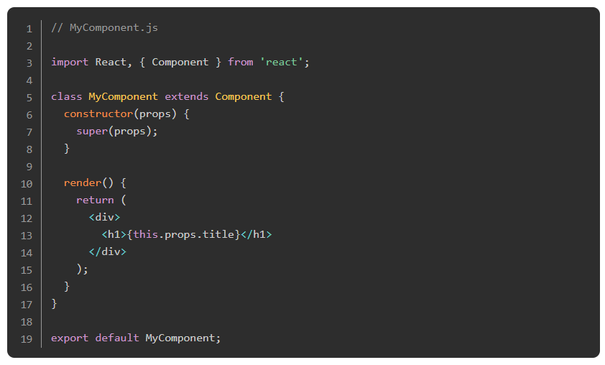
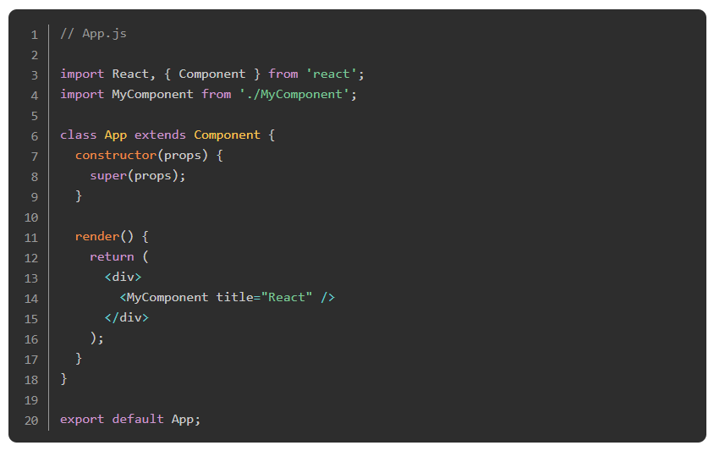
Props
Let’s take the following example:

Slide 6
Props
Let’s take a look at what is happening here. Above, there are two components, MyComponent and App. As you can see, MyComponent is imported into App, and then rendered as a child component of App. In the JSX where we implement MyComponent, we also pass down a property called title. This syntax should look familiar to you: it’s the same way we assign attributes to HTML elements. In this specific example, we assign a “prop” (short for property, as in an object property) called title which we set to the value "React". In MyComponent, we can access this “prop” from within MyComponent with the syntax this.props.title. This technique is called “passing props.”
IMPORTANT: Make sure you pass props to the constructor of the child component (MyComponent) as well as the super() method, otherwise you will not be able to access this.props.title in MyComponent. You might be confused by this keyword since you may not yet have encountered it, but don’t worry. For right now it’s enough to just know that you must use it for your React component to function correctly. If you’re really curious about what super actually does, check out the docs.

Slide 7
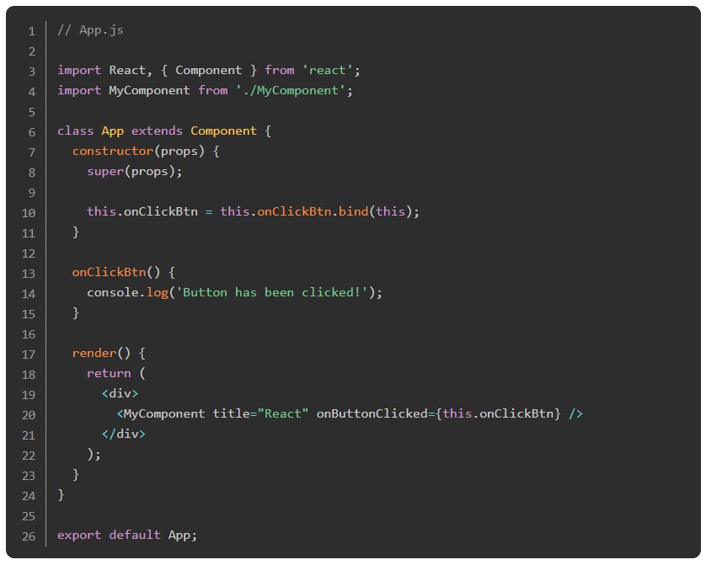
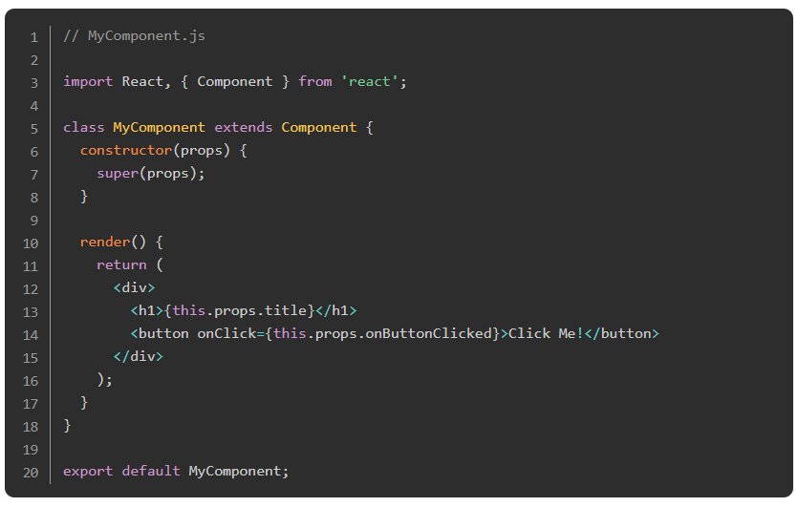
Props
Now, you might be wondering how props work with functions. Believe it or not, they work the same way!

Slide 8
Props
Ok, there is a little bit more going on here, but in the end, it works exactly as in the example before. First, there is MyComponent, which is essentially the same except one key difference: {this.props.onButtonClicked} is assigned to the onClick event of the component. Essentially, what this means is:
Our MyComponent component is expecting a prop to be passed into it named onButtonClicked
The value of that prop should be some kind of function
We want this function to be attached to the click event of our button.

Slide 9
Props
Special note 1: In React, instead of using addEventListener to add event listeners, we assign them right in the JSX. Unlike adding them in HTML, these attributes must be camelCased! You can view a list of all supported events here.

Slide 10
Props
Special note 2: Did you notice how the function this.props.onButtonClicked was wrapped in curly braces? This is because JSX needs a way of knowing when you are using JavaScript, otherwise it will try to transpile your code into HTML elements, text nodes, or strings (or throw an error in some cases). In this case, we are referring to a JavaScript object property, which technically qualifies as “using JavaScript,” so we must wrap it in curly braces.

Slide 11
Props
Now onto the App component. First, we defined the method onClickBtn above the render method. After that, we passed this function down to our MyComponent as a prop, which we named onButtonClicked (of course, you could also name it onClickBtn and then use that function in MyComponent.js with the name of onClickBtn, but we wanted to emphasize that you can rename the functions when passing them around as props). We do that in the same way that we passed the title value previously, except instead of passing a string, we’re just passing a function (and using curly braces to do so because it’s a JavaScript variable).
Now the only thing we have to do is bind the method to this; we do that in the constructor method at the top of our component but below the super() call. The reason we have to bind the this keyword when passing a function to another component is that it needs to stay in the same context in which it was declared. Always remember: you must bind this for all methods in class components when passing them to other components.

Slide 12
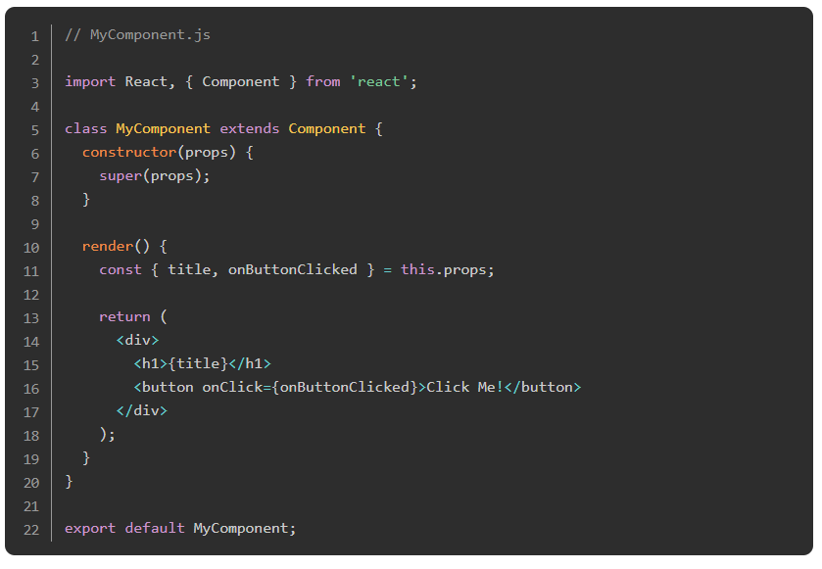
Props
As you can see when you are passing many properties or functions to a component, it can get quite exhausting to always refer to them with this.props.someProperty. Destructuring to the rescue! We can alternatively write the above as follows:

Slide 13
Props
Here, we are destructuring title and onButtonClicked from this.props, which lets us refer to them with just their names. Make sure to destructure within the render method when using class components. In functional components, you would destructure outside of the return statement or inside the parameter parentheses of the functional component (more on those later).
Great! Hopefully, you have a better understanding of the purpose and usage of props in React. Not too shabby! At this point, if you’re feeling overwhelmed, don’t fret! Once you start using props in your projects, you’ll understand them much better. Soon enough, you’ll be a props master!

Slide 14
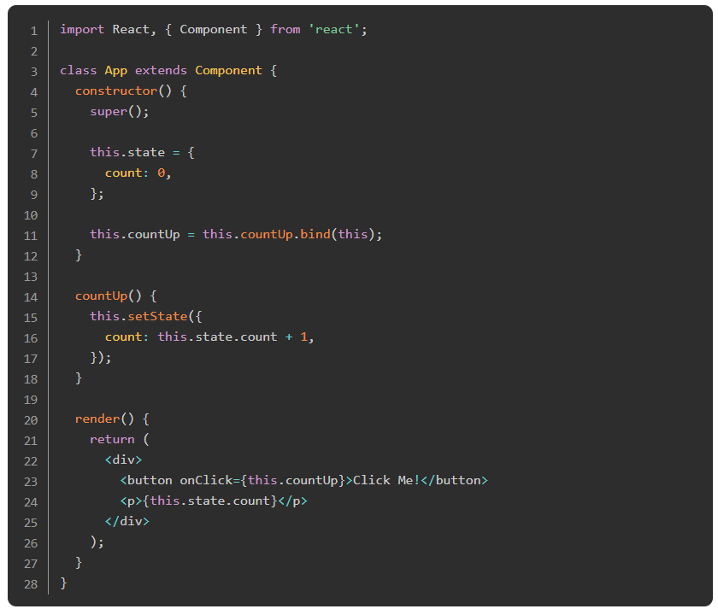
States
The other main pillar of React is state. State is simply what we use to handle values that can change over time. For example, consider a very simple application that has a button and a counter. When the user clicks the button, the counter is incremented by 1. Since count will need to change on every click, we want to hold that value in state.
The following example of our simple counter app shows how to define state in React:

Slide 15
States
In the previous component, we declared our state as an object with a property count set to an initial value of 0. You always declare state in the constructor of a class component. Once again, this will work differently when we cover functional components later. The setState method we call inside the countUp method sets the state to a new value.
IMPORTANT: In React, state should be treated as immutable. This means you should never change state directly (i.e. without using setState) because it can lead to unexpected behavior or bugs.

Slide 16
States
In other words, you should never do something like: this.state.count = 3, or, this.state.count++. Instead, always use the setState method React provides to class components to modify the state. Keep this in mind - it can save you a lot of debugging when you are getting started with React. This article does a great job analyzing many popular JavaScript methods concerning mutability. Take some time to read it so you can understand how easy it can be to accidentally mutate state.

Slide 17
States
As we mentioned before, our countUp() method needs to be bound in our constructor (using bind), so it knows what context to operate in. This is a result of how this works in JavaScript, see this article for a great explanation on why this is the case.
In the render method, we access the current state through this.state.count. This syntax should look familiar to you by now because it is the same way we accessed props. And yes, you can also destructure state.

Slide 18
What about passing state as a prop? Is that even legal?
Yes! One of the greatest and most powerful features of React is the ability to pass one component’s state down to multiple children. When that piece of state is changed, each child component that uses it is automatically re-rendered with the new value!
Consider a webpage such as a forum where the “main” component of the site (we’ll call that component Forum) needed to know the user’s username so that when they are viewing a post or reply they wrote, the author is shown as “me” instead of “user123”. You’d probably want to keep that username as a piece of data in state so each user that visited the site and logged in could have this functionality. Now let’s say on that same site, you want the login button on the navigation bar to change into the user’s username to visually indicate to them that they are logged in. Instead of keeping this piece of state in both the NavBar and Forum component, we can keep it in their parent, App, and pass it down as a prop to both like so:

Slide 19
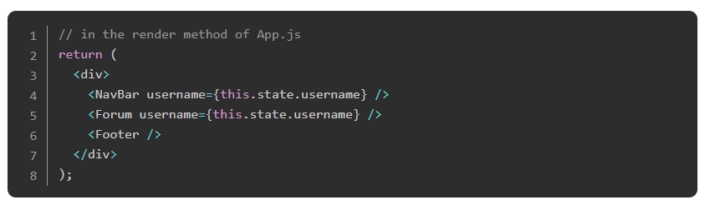
States
Now, when the user logs in, both the NavBar and Forum components will update, but the Footer component (which doesn’t need to know about that data) will not re-render. Pretty cool, right?

Slide 20
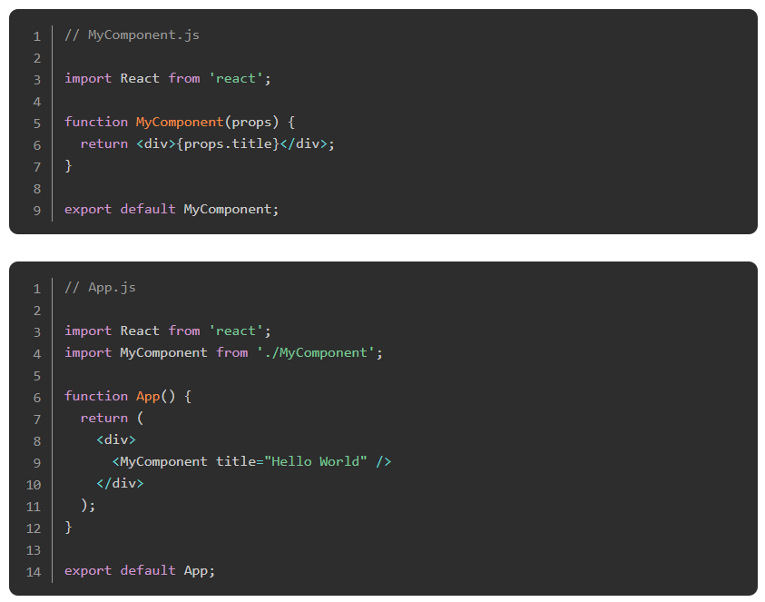
State and props in functional components
As we learned in the previous lesson, and repeatedly made reference to in this lesson, React provides the ability to create components as functions instead of classes. We call these functional components. They use somewhat different syntax than the class components we’ve discussed thus far, but they essentially do that same thing. In functional components, we don’t pass props as an argument to the constructor, but instead just pass it as an argument to the component itself. Another major difference between functional and class components concerning props is the way you reference the props. You learned that in a class component, the props that have been passed down from the parent component can be used with this syntax: this.props.someFunction, however in functional components, we don’t need to reference this, so we access props simply with: props.someFunction. That’s the main difference with props between class and functional components. Let consider a quick example to solidify this:

Slide 21
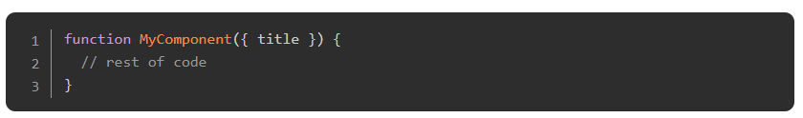
States
Of course, we can also destructure from props here. By adding the line const {title} = props above the return statement in MyComponent.js we can just refer to the title using {title}. Or, we can skip that line of code altogether if we destructure the prop inside the parameter parentheses like so:

Slide 22
States
Using state in functional components is a bit different. Before the end of 2018, developers were not able to access state in functional components at all. Functional components were therefore just used for returning JSX logic with props. However, with the introduction of React Hooks, this changed. Now we can set and access state in functional components, and in the modern React landscape, they are often preferred over class components. React developers will be exposed to both kinds of components on the job, so it’s imperative for us to be very familiar with both. The way React hooks work is the topic of one of the following lessons, so don’t worry about it right now. We are setting you up to say “Hey! I remember that” when it’s introduced.

Slide 23
Read about props
Go to the React homepage and go through the props section again. Also, check out the next article, which talks about State and Lifecycle Methods. Don’t worry about the lifecycle methods for now, we will discuss them in a future lesson. However, if you are excited and want to learn more, feel free to explore that on your own.

Slide 24
Try this…
Starting with this lesson on props, continue through each of the lessons relating to state and props to build a good foundation for the upcoming lessons. Once again, you’re welcome to explore more on your own if you wish.

Slide 25
Knowledge Check

Slide 26
How do you pass functions, state, or other values between components?
Notes:
🍐 This is a Pear Deck Text Slide
🍐 To edit the type of question, go back to the "Ask Students a Question" in the Pear Deck sidebar.

Slide 27
What is the purpose of state in a React component?
Notes:
🍐 This is a Pear Deck Text Slide
🍐 To edit the type of question, go back to the "Ask Students a Question" in the Pear Deck sidebar.

Slide 28
Explain the importance of using setState() instead of mutating state directly?
Notes:
🍐 This is a Pear Deck Text Slide
🍐 To edit the type of question, go back to the "Ask Students a Question" in the Pear Deck sidebar.

Slide 29
What is the difference between functional and class components and how does their syntax for handling props differ?
Notes:
🍐 This is a Pear Deck Text Slide
🍐 To edit the type of question, go back to the "Ask Students a Question" in the Pear Deck sidebar.

Slide 30
How do you attach event listeners to elements in React components?

Slide 31
Resources
This course is a great way to get more familiar with all basic concepts of React in a very short time.
An article by the React team on the thought process that should go into the developer’s minds while building a React based application.

